Slide 1
Data Structures
and
Algorithms
CSCI 237 –
Fall 2019

Slide 2
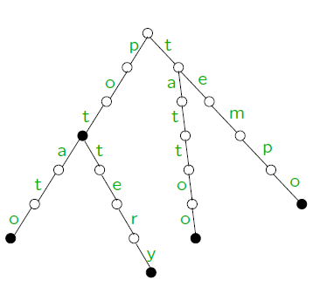

Graph Problems
What is a graph?
Graph can be thought of as a collection of points called vertices, some of which are connected by line segments called edges.
Examples:

Slide 3

Graph Problems
Graph Terminology
G= (V,E) V – Vertices E – Edges
V = {a,b,c,d,e,f}
E = {(a,c),(a,d),(b,c),(b,f),(c,e),(d,e),(e,f)}
V = {a,b,c,d,e,f}
E = {(a,c),(d,a),(b,c),(b,f),(c,e),(d,e),(e,c),(e,f)}
Loop
Cycles (Acyclic)
Dense
Sparse

Slide 4
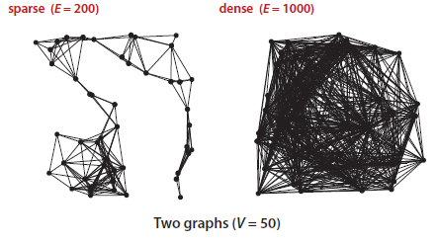
Sparse and Dense Graphs

Slide 5
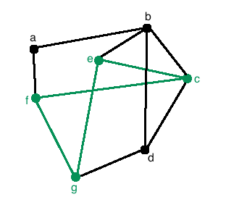
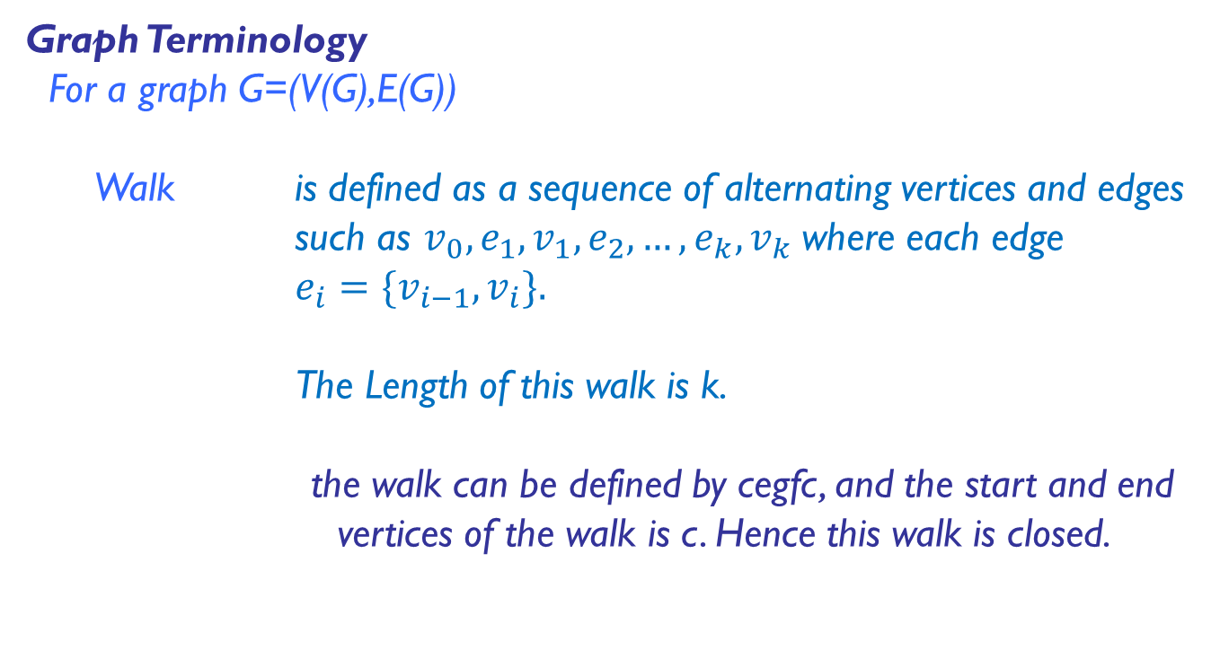
Graph Problems
Graph Terminology
For a graph G=(V(G),E(G))
Walk is defined as a sequence of alternating vertices and edges such as $v_{0},e_{1},v_{1},e_{2},…,e_{k},v_{k}$where each edge
$e_{i}=\{v_{i−1},v_{i}\}.$
The Length of this walk is k.
the walk can be defined by cegfc, and the start and end vertices of the walk is c. Hence this walk is closed.

Slide 6
Graph Problems
Graph Terminology
For a graph G=(V(G),E(G))
Trail is defined as a walk with no repeated edges.
Circuit is a closed trail. That is, a circuit has no repeated edges but may have repeated vertices.
Path is a trail in which all vertices are distinct.
Connected A path exists between every pair of vertex.

Slide 7
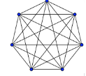
Graph Problems
Graph Terminology
For a graph G=(V(G),E(G))
Cycle is defined as a closed trail where no other vertices are repeated apart from the start/end vertex.
Loop is defined as a closed trail from node to itself in one step.
Complete Graph Simple undirected graph in
which every pair of distinct
vertices is connected by a
unique edge

Slide 8
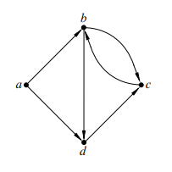
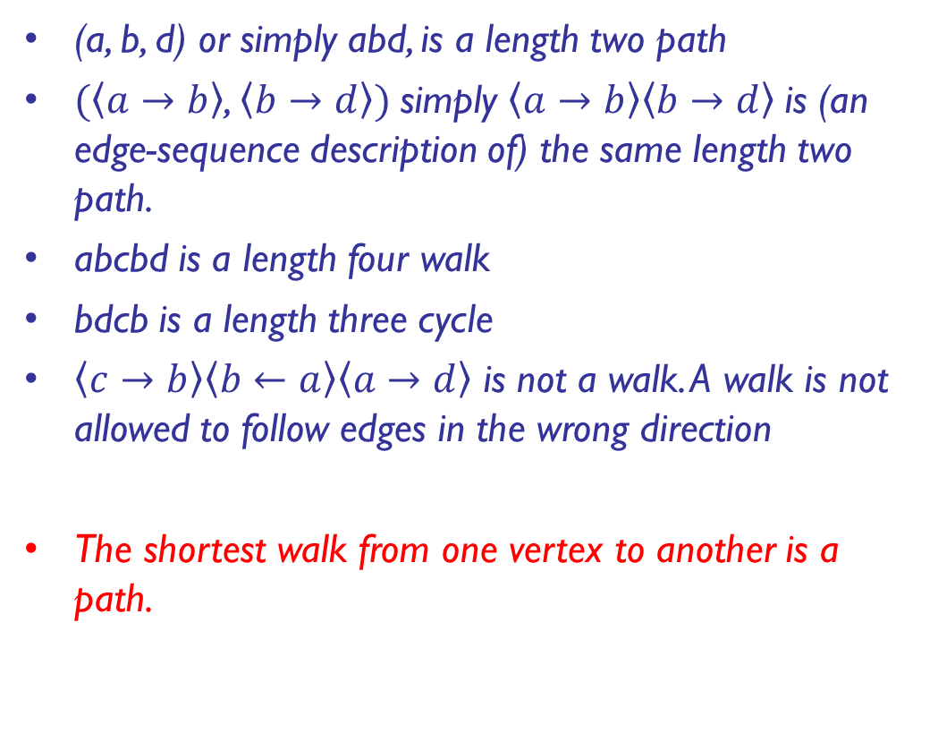
Graph Problems
(a, b, d) or simply abd, is a length two path
$(\left\langle a→b\right\rangle$, $\left\langle b→d\right\rangle )$simply $\left\langle a→b\right\rangle \left\langle b→d\right\rangle$is (an edge-sequence description of) the same length two path.
abcbd is a length four walk
bdcb is a length three cycle
$\left\langle c→b\right\rangle \left\langle b←a\right\rangle \left\langle a→d\right\rangle$ is not a walk. A walk is not allowed to follow edges in the wrong direction
The shortest walk from one vertex to another is a path.

Slide 9
Graphs
We have the following inequality for the number of edges |E|
possible in an undirected graph with |V | vertices and no loops:
Min: (|V| − 1) ≤ |E| ≤ Max:|V|(|V| − 1)/2

Slide 10
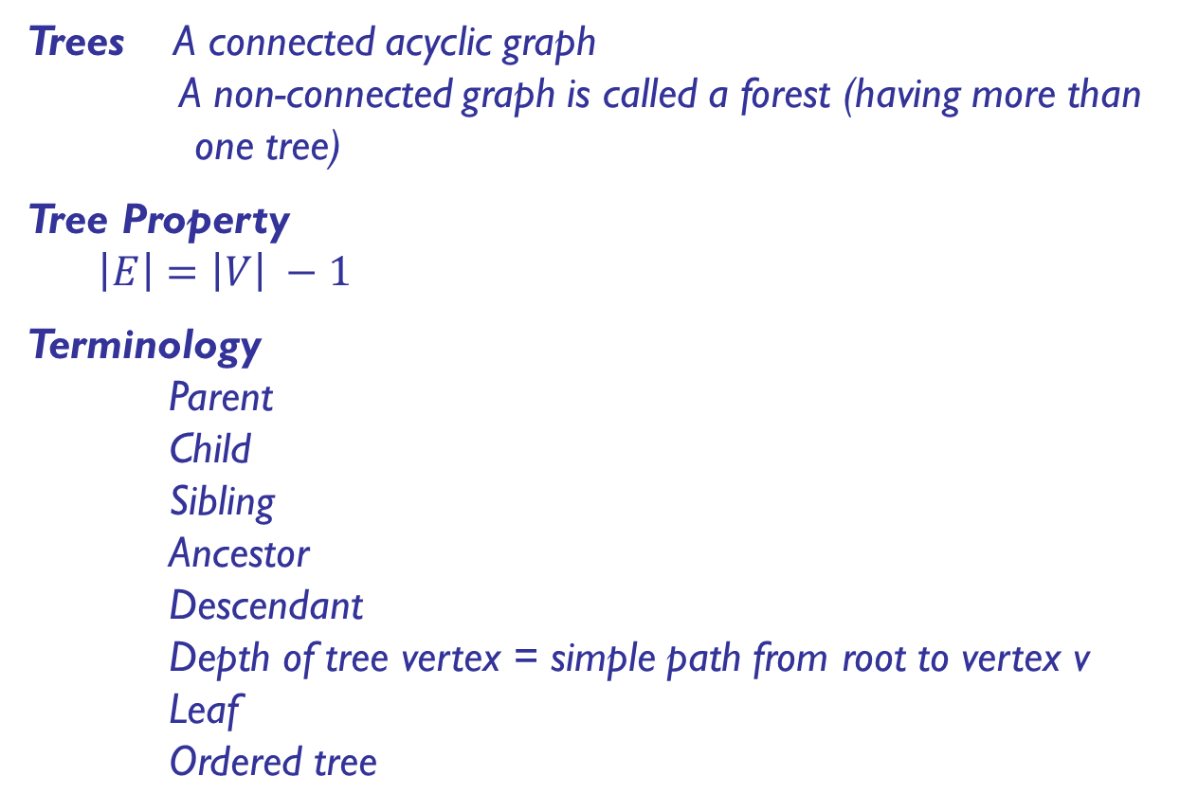
Graph Problems
Trees A connected acyclic graph
A non-connected graph is called a forest (having more than one tree)
Tree Property
$\left|E\right|=\left|V\right| −1$
Terminology
Parent
Child
Sibling
Ancestor
Descendant
Depth of tree vertex = simple path from root to vertex v
Leaf
Ordered tree

Slide 11
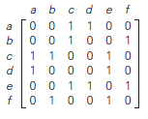
Representing Graphs
Three data structures that immediately suggest themselves for representing graphs:
An adjacency matrix, where we maintain a V-by-V boolean array, with the entry in row v and column w defined to be true if there is an edge adjacent to both vertex v and vertex w in the graph, and to be false otherwise.
This representation fails on the first count—graphs with millions of vertices are common and the space cost for the V² boolean values needed is prohibitive.

Slide 12
Representing Graphs
Three data structures that immediately suggest themselves for representing graphs:
An array of edges, using an Edge class with two instance variables of type int.
This direct representation is simple, but it fails on the second count—implementing adj() would involve examining all the edges in the graph.

Slide 13
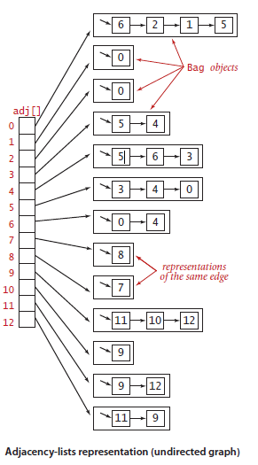
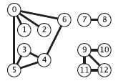
Representing Graphs
Three data structures that immediately suggest themselves for representing graphs:
An array of adjacency lists, where we maintain a vertex-indexed array of lists of the vertices adjacent to each vertex.
This data structure satisfies both requirements for typical applications and is the one that we will use throughout our discussions.

Slide 14
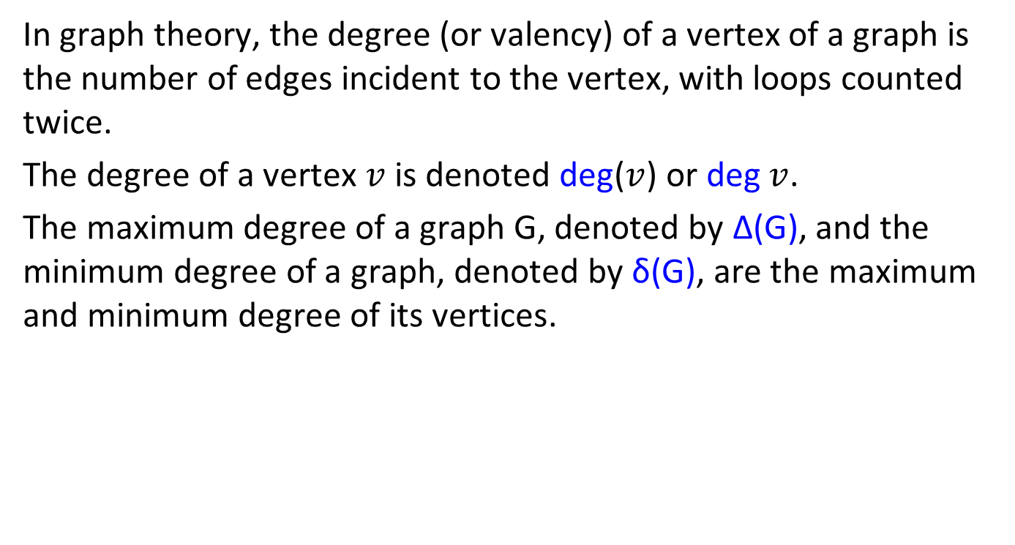
Degree or Valency of a Vertex
In graph theory, the degree (or valency) of a vertex of a graph is the number of edges incident to the vertex, with loops counted twice.
The degree of a vertex $v$ is denoted deg($v$) or deg $v$.
The maximum degree of a graph G, denoted by Δ(G), and the minimum degree of a graph, denoted by δ(G), are the maximum and minimum degree of its vertices.

Slide 15
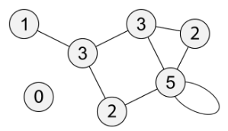
Degree or Valency of a Vertex
In the following graph, the maximum degree is 5 and the minimum degree is 0.
Directed Graph: In-Degree, Out-Degree

Slide 16
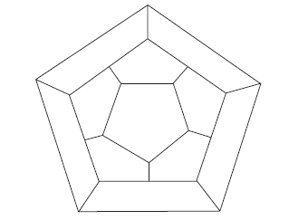
Example
Icosian Game - This one invented by the renowned Irish mathematician Sir William Hamilton (1805–1865)—was presented to the world under the name of the Icosian Game.
Let us convert the game board to a graph.

Slide 17
Example
Icosian Game - This one invented by the renowned Irish mathematician Sir William Hamilton (1805–1865)—was presented to the world under the name of the Icosian Game.
Let us convert the game board to a graph.
a
f
b
j
g
k
e
c
i
h
d

Slide 18
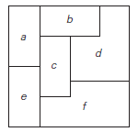
Example
Consider the following map:
Represent the map as a graph.
Color the vertices using the following rule: no two adjacent vertices are colored the same.
What is the smallest number of colors needed in part (b)?

Slide 19
Partitioning Graph
In graph theory, a part of mathematics, a k-partite graph is a graph whose vertices are or can be partitioned into k different independent sets.
Equivalently, it is a graph that can be colored with k colors, so that no two endpoints of an edge have the same color.
When k = 2 these are the bipartite graphs, and when k = 3 they are called the tripartite graphs.

Slide 20
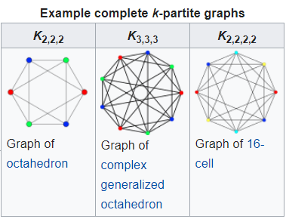
Partitioning Graph
When k = 2 these are the bipartite graphs, and when k = 3 they are called the tripartite graphs.

Slide 21
Graphs
Sets
- Collection of unordered distinct elements (use of Multiset concept)
Multiset: In mathematics, a multiset (aka bag or mset) is a modification of the concept of a set that, unlike a set, allows for multiple instances for each of its elements. The positive integer number of instances, given for each element is called the multiplicity of this element in the multiset.
- Universal set

Slide 22
Graphs
Dictionary: A data structure that implements the three operations SEARCH: searching for a given item,
ADD: adding a new item, and
DELETE: deleting an item
from the collection is called the dictionary.
Problems involving operations with sets:
- Applications in computing which require a dynamic partition of some n-element set into a collection of disjoint subsets.

Slide 23
Summary
In Summary:
The non-ambiguity requirement for each step of an algorithm cannot be compromised;
The range of inputs for which an algorithm works has to be speciﬁed carefully;
There may exist several algorithms for solving the same problem;
The same algorithm can be implemented in several different ways.

Slide 24
Questions ?!

